Slide 1
NLP TEXT ANALYSIS
Bright Benard
2100702287

Slide 2
Steps include
Exploratory Data Analysis
Tokenize the string into words
Lower casing.
Remove stop words like “and, is, a, on, etc.”
Stemming and lemmatization
K Means algorithm
Word cloud

Slide 3
Exploratory Data Analysis
Data that is used refers to comments from an internship period.
The data was preprocessed using the following;
An exploratory data analysis was made and this include analysing the dataset head, the shape, description and information statistics. Null values were also assessed and dropped. Punctuations were also removed
Then the data frame was changed to lowercase, tokenized, remove stop words and conversion of each word into a stem and lemma

Slide 4
Stemmers and Lemmas
Porter_stemmer library is used for stemming the clean dataset whereas a WordNetLemmatizer is used for lemmatization of same dataset. Whereas lemma maintain the meaning of the words in a conversation. Stemmed words tend to change the grammatical significance of the sentences in a dataset.

Slide 5
Corpus Processing
A corpus was processed using the NLTK that reads an entire corpus from a directory (the ‘root’ directory). As it reads in corpus, it applies word tokenization and sentence tokenization.
A vectorizer was implemented using the CountVectorizer and fitted unto the corpus that is transformed into an array. To vectorize a corpus with a bag-of-words (BOW) approach, we represent every document from the corpus as a vector whose length is equal to the vocabulary of the corpus.

Slide 6
Clustering in Text Analysis
K Means Clustering technique
Different libraries are required for the effective clustering. These include sklearn feature_extraction, pandas, numpy, pylab, sklearn.pipeline, sklearn.decomposition, sklearn.preprocessing, time and matplotlib.pyplot.
With the corpus .split function, we use a TFIDF vectorizer to produce Sparse Matrix of features. Time in terms of the number of epochs is measured in seconds.
The TFIDVectorizer takes in the maximum and minimum of the dataframe plus the stopwords and computes the number of samples and the number of features to be compared.
The kmeans cosine similarity matrix is created and a list that holds the SSE values for each k

Slide 7
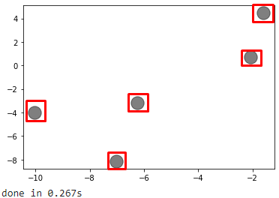
Scatter Plot
Figure: Showing the number clusters predicted by k means algorithm

Slide 8
Performance Validation
Performance of the performance of the algorithm is given by both the elbow and silhouette coefficient value.
The kelbow method plots an elbow curve to find the “K” value. Silhouette method however shows the performance of several values of k.

Slide 9
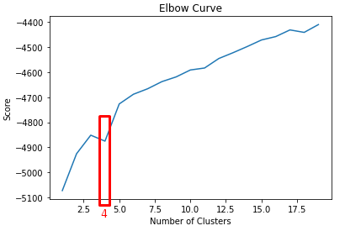
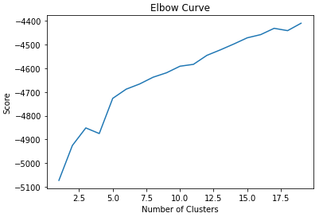
Elbow Method
Figure: Showing the number of clusters created using the elbow methods

Slide 10
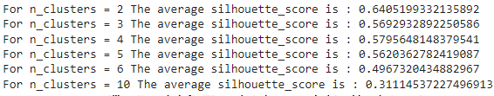
Silhouette Coefficient values method
From the silhoutte_score n= 2 is the highest but not optimal. Wee notice that for n = 3, 4 and 5 depict the convergence and the optimal coefficient would be n=4 where the sil_value= 0.57

Slide 11
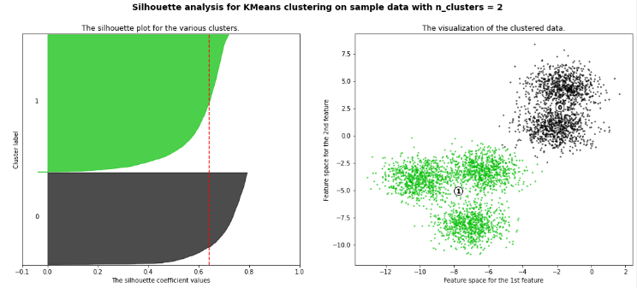
Silhouette at n_clusters=2
You notice that many more clusters can be made out of the 2 clusters even by viewing the color variation

Slide 12
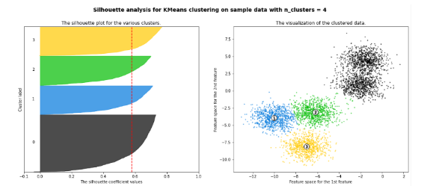
Silhouette at n_clusters=4
Performance is optimized at n_clusters=4 as shown in the diagram below

Slide 13
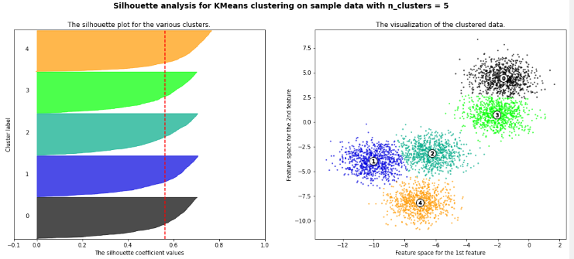
Silhouette at n_clusters=5
Performance in clusters is best at 5 where evidently the clusters are even distinct to a naked eye

Slide 14
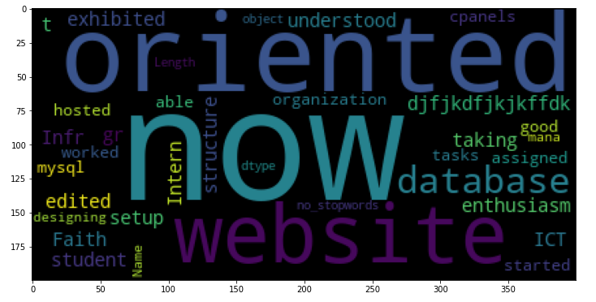
Word Cloud
Wordcloud package generates an image that gives us the more common in our comments

Slide 15
NAMED ENTITY RECOGNITION
NER

Slide 16
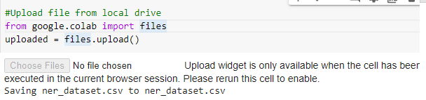
Criteria followed
Data is uploaded using:

Slide 17
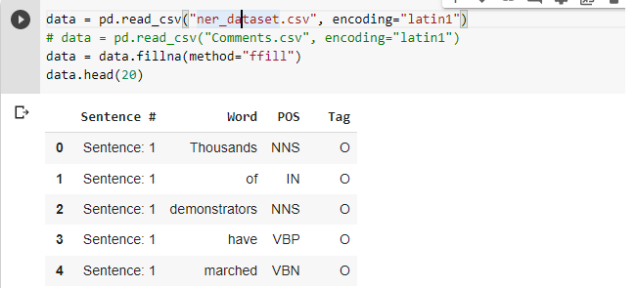
Encode uploaded data

Slide 18
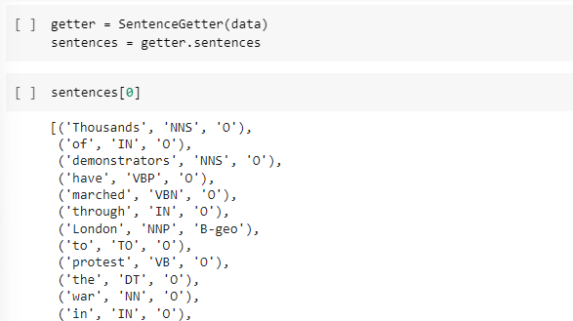
More preprocessing
Unique words in corpus are identified along with their tags. 35178 unique words were discovered and 17 unique tags were identified.
Retrieve sentences and corresponding tags

Slide 19
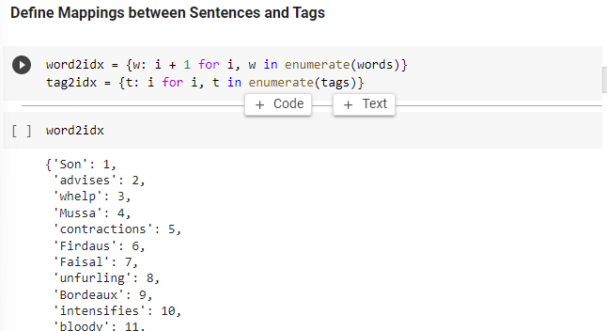
Define mappings between sentences and tags

Slide 20

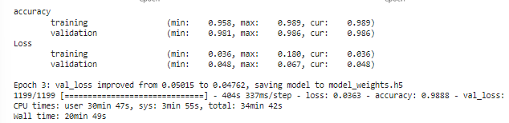
Model Training
The number of epochs is a hyperparameter of gradient descent that controls the number of complete passes through the training dataset
Our model learns with a high level of accuracy and a small loss is incurred in the historical lessons learnt by this model

Slide 21
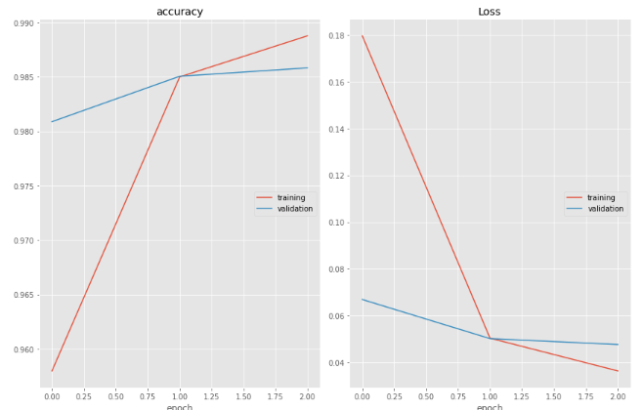

Slide 22
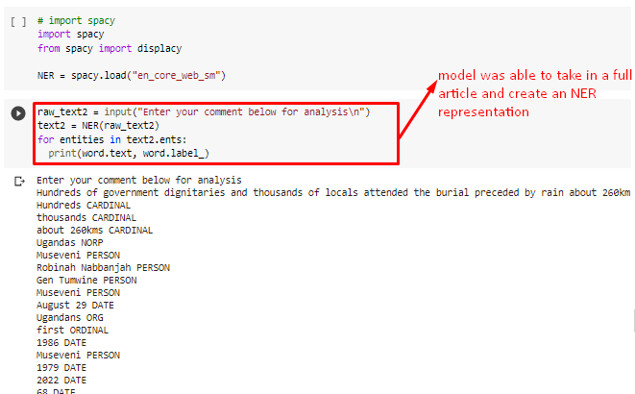
NER Input and transformation

Slide 23
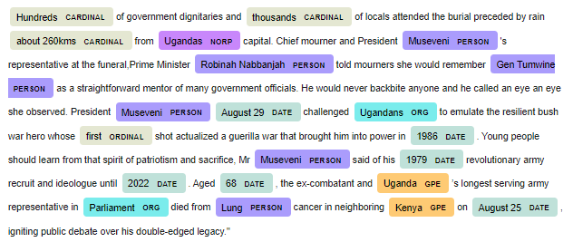
NER Representation

